Slide 1

Comprehensive Patient Care: Developing a Scalable SQL Database for Streamlined Healthcare Management
Harika Mareddy

Slide 2

Project Scope
The project scope entails developing a comprehensive healthcare management system by integrating a centralized SQL database. This system will efficiently manage patient data, including demographics, medical history, admissions, treatments, and billing, to streamline healthcare processes and enhance decision-making. By leveraging MySQL workbench for data storage, the project ensures scalability, data integrity, and accessibility. Analytical tools, such as Python, will facilitate exploratory data analysis and visualization to uncover trends in patient care. The system is designed to minimize redundancies, optimize hospital operations, and support real-time data querying, thereby improving patient outcomes and organizational efficiency.

Slide 3

Aim
The aim of this project is to analyze a healthcare dataset by developing a centralized SQL database to manage patient data and admissions efficiently. By leveraging SQL queries and visualizations, the project identifies trends in medical conditions, admissions, and patient demographics, providing actionable insights. This work establishes a foundation for future healthcare management systems, ensuring accurate, scalable, and effective data handling.

Slide 4

Data Collection
The data for this project was sourced from kaggle, a publicly available platform. The following dataset was utilized in the project.
Dataset link: https://www.kaggle.com/datasets/prasad22/healthcare-dataset/data

Slide 5

Methodology
Data Collection and Preprocessing:
The project begins with data collection from Kaggle, followed by data cleaning and preprocessing to ensure consistency by removing duplicates and handling missing values.
Exploratory Data Analysis (EDA):
To prepare the dataset for analysis, EDA was conducted to ensure data quality and uncover insights. This included identifying and handling null values, inspecting the dataset structure, and converting data types for consistency. Patterns in patient demographics, admission types, and billing amounts were analyzed using visualizations such as bar charts, line plots, and heatmaps. These findings informed the design of the database schema and guided the project objectives.
Database Design:
A structured SQL database was designed in MySQL Workbench with normalized tables to manage patient records, admissions, and medications efficiently. The schema was optimized to ensure data integrity and scalability.
Data Visualization and Analysis:
Python was utilized for data visualization and analysis, providing insights into patient demographics, healthcare trends, and resource allocation.

Slide 6
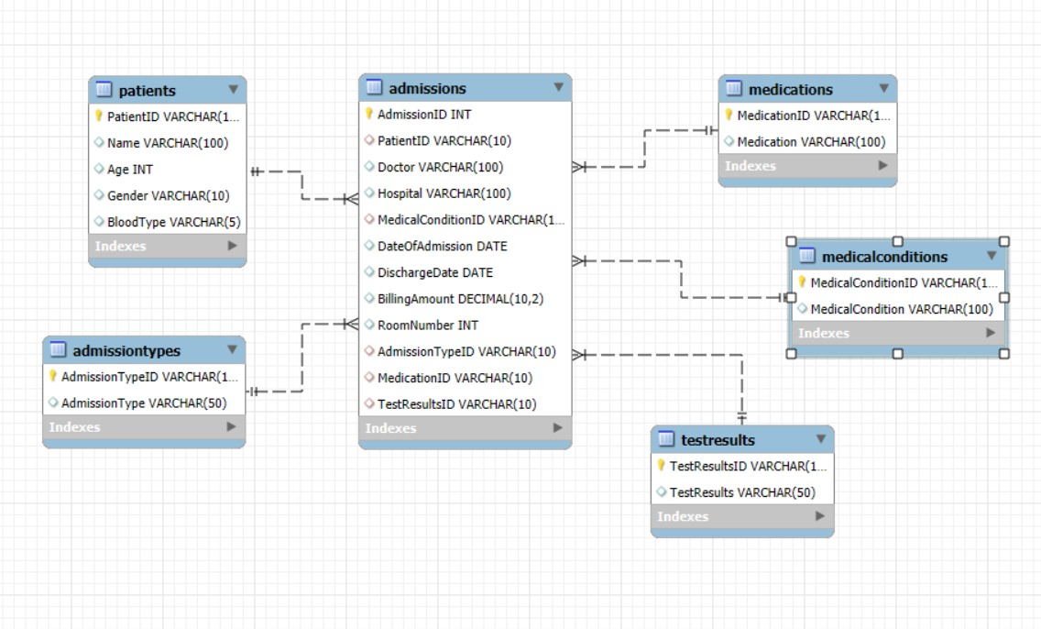
Entity-Relationship Diagram

Slide 7
Relationships
patients → admissions: One-to-Many
admissions → medicalconditions: Many-to-One
admissions → admissiontypes: Many-to-One
admissions → medications: Many-to-One
admissions → testresults: Many-to-One

Slide 8
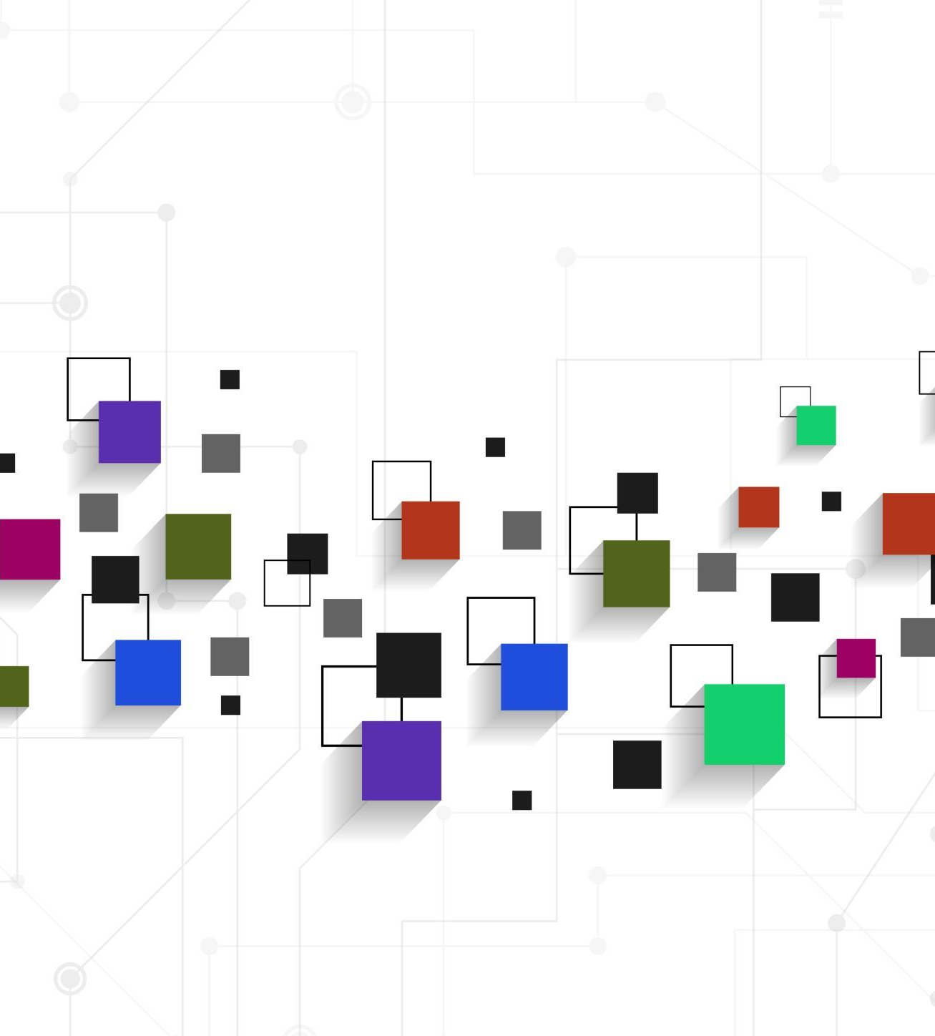
Database Normalization
The database design adheres to the principles of Third Normal Form (3NF), eliminating partial and transitive dependencies. All non-key attributes are directly dependent on the primary key of their respective tables without any transitive relationships.
By following 3NF guidelines, this design minimizes data redundancy, prevents update anomalies, and ensures data integrity. As a result, no additional normalization is necessary for this structure.

Slide 9
Evaluating Cardinality and Justification for MedicalConditions Table
Cardinality Between MedicalConditions and Admissions:
The relationship between medicalconditions and admissions is Many-to-One, meaning multiple admissions can share the same medical condition, but each admission is linked to only one medical condition.
This structure ensures that medical conditions are not duplicated across multiple admissions, allowing for consistency and better normalization. For example, if "Diabetes" is recorded as a medical condition, it is referenced using its unique MedicalConditionID rather than being duplicated across admissions.
Why the MedicalConditions Table is Necessary:
The MedicalConditions table is essential for scalability, efficiency, and data integrity. While it currently maps only to condition names, it allows for future expansion with attributes like severity, ICD codes, or symptoms without redesigning the schema. Separating medical conditions ensures efficient updates; for example, updating "Hypertension" to "Hypertension - Stage 1" requires only one change in the table, with all references automatically consistent. This design minimizes redundancy, as conditions like "Hypertension" are stored once and referenced by their IDs, saving storage space. Additionally, it aligns with database normalization principles, maintaining a clean, flexible structure that supports interoperability and evolving healthcare needs.

Slide 10
Patients Table:
Attributes: PatientID (PK), Name, Age, Gender, BloodType
Relationship: Linked to Admissions Table through PatientID (FK)
Admissions Table:
Attributes: AdmissionID (PK), Doctor, Hospital, DateOfAdmission, DischargeDate, BillingAmount, RoomNumber
Relationships:
MedicalConditionID (FK referencing MedicalConditions)
AdmissionTypeID (FK referencing AdmissionTypes)
MedicationID (FK referencing Medications)
TestResultID (FK referencing TestResults)
MedicalConditions Table:
Attributes: MedicalConditionID (PK), MedicalCondition
Relationship: Linked to Admissions Table via MedicalConditionID (FK)

Slide 11
4. AdmissionTypes Table:
Attributes: AdmissionTypeID (PK), AdmissionType
Relationship: Linked to Admissions Table via AdmissionTypeID (FK)
5. Medications Table:
Attributes: MedicationID (PK), Medication
Relationship: Linked to Admissions Table via MedicationID (FK)
6. TestResults Table:
Attributes: TestResultID (PK), TestResults
Relationship: Linked to Admissions Table via TestResultID (FK)

Slide 12
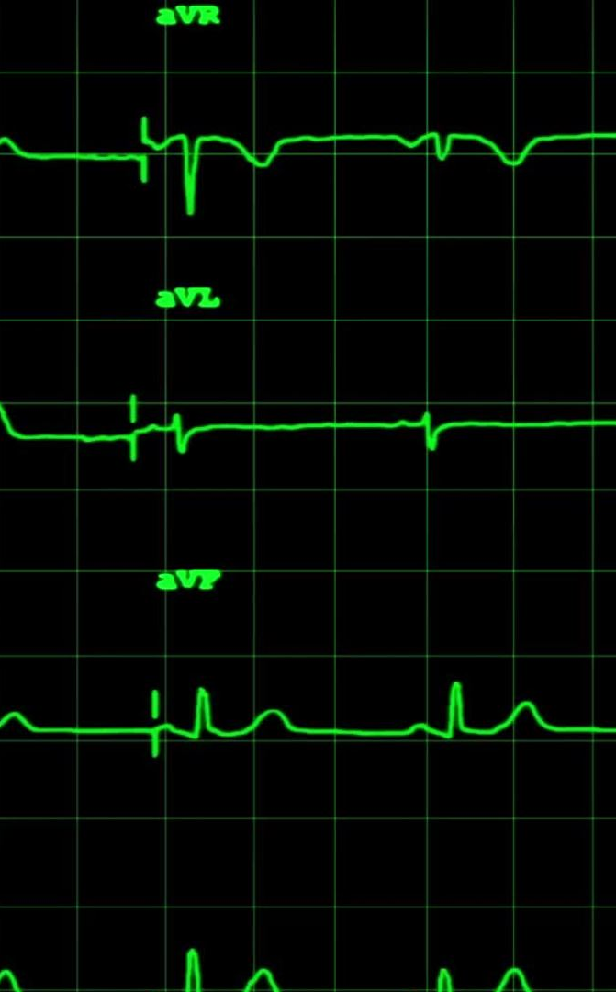
Data Types
Patients Table:
PatientID: VARCHAR(10) (Primary Key)
Name: VARCHAR(100), Age: INT, Gender: VARCHAR(10), BloodType: VARCHAR(5)
Admissions Table:
AdmissionID: INT (Primary Key), PatientID: VARCHAR(10) (Foreign Key)
Doctor: VARCHAR(100), Hospital: VARCHAR(100)
MedicalConditionID: VARCHAR(10), AdmissionTypeID: VARCHAR(10), MedicationID: VARCHAR(10), TestResultID: VARCHAR(10) (All Foreign Keys)
DateOfAdmission: DATE, DischargeDate: DATE, BillingAmount: DECIMAL(10,2), RoomNumber: INT
MedicalConditions Table:
MedicalConditionID: VARCHAR(10) (Primary Key), MedicalCondition: VARCHAR(100)
AdmissionTypes Table:
AdmissionTypeID: VARCHAR(10) (Primary Key), AdmissionType: VARCHAR(50)
Medications Table:
MedicationID: VARCHAR(10) (Primary Key), Medication: VARCHAR(100)
TestResults Table:
TestResultID: VARCHAR(10) (Primary Key), TestResults: VARCHAR(50)

Slide 13
Data cleaning
Handling Missing Values: Missing entries in the dataset were identified and addressed by either imputing appropriate values or removing incomplete records to maintain data integrity.
Duplicate Removal: Duplicate records were identified and eliminated to ensure data accuracy and avoid redundancy in analysis.
Standardization: Inconsistent formatting, such as case sensitivity in names and other textual data, was standardized to ensure uniformity across the dataset.
Outlier Detection and Correction: Outliers in numerical columns like age and billing amounts were detected and handled to avoid skewing the analysis results.

Slide 14
Data Preprocessing & Managing Null Values
Data Preprocessing:
Importing Libraries: Libraries like pandas, numpy, and matplotlib are imported, indicating plans for data manipulation, numerical operations, and visualization.
Initial Data Inspection: The dataset is previewed using methods like .head() to understand its structure and identify potential issues.
Data Type Conversion: Conversion of data types (e.g., astype(float) for numerical analysis) ensures consistency in operations.
Managing Null Values:
Identifying Nulls: Inspection of nulls is performed using df.isnull().sum(), which identifies columns with missing values and their counts.
Handling Nulls in SQL Queries: Filters like IS NOT NULL are used in SQL queries to exclude rows with missing values during data retrieval.

Slide 15
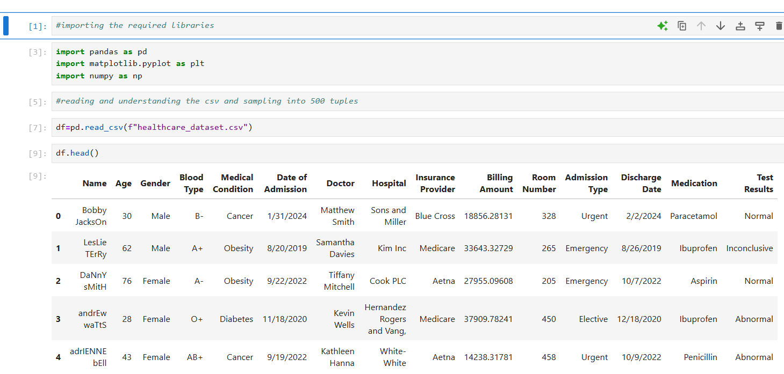

Slide 16
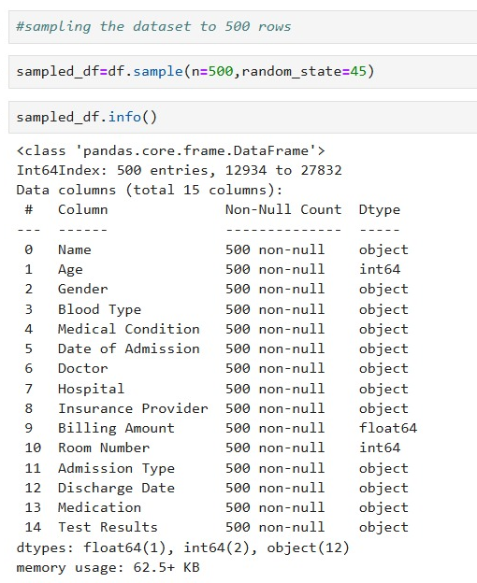
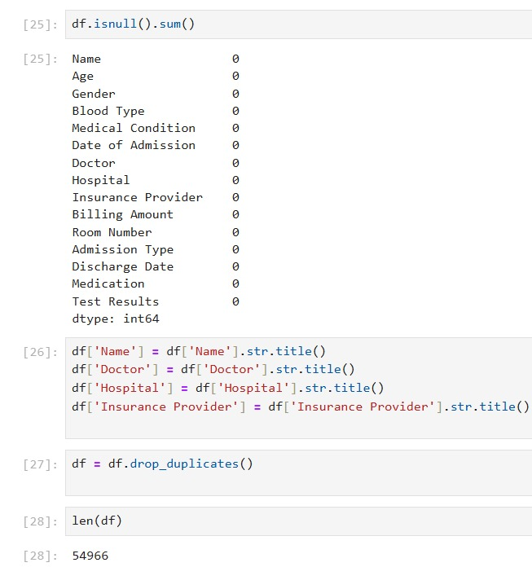
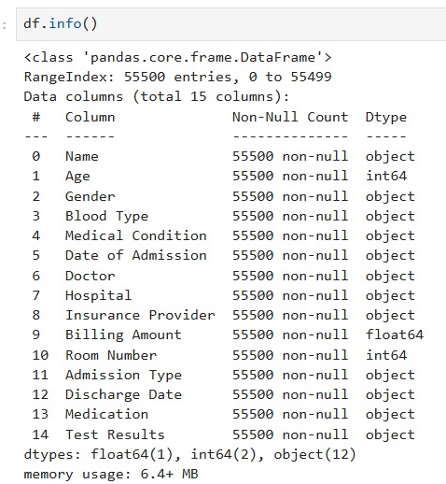

Slide 17
Database Connection
To retrieve and interact with information, we established a connection to a MySQL database using MySQL Workbench and Jupyter Notebook.
The MySQL.Connector library was utilized to enable Python to act as an interface with the database, facilitating seamless communication for executing queries and retrieving results. This setup allowed for efficient data management and analysis directly within the Jupyter environment.

Slide 18
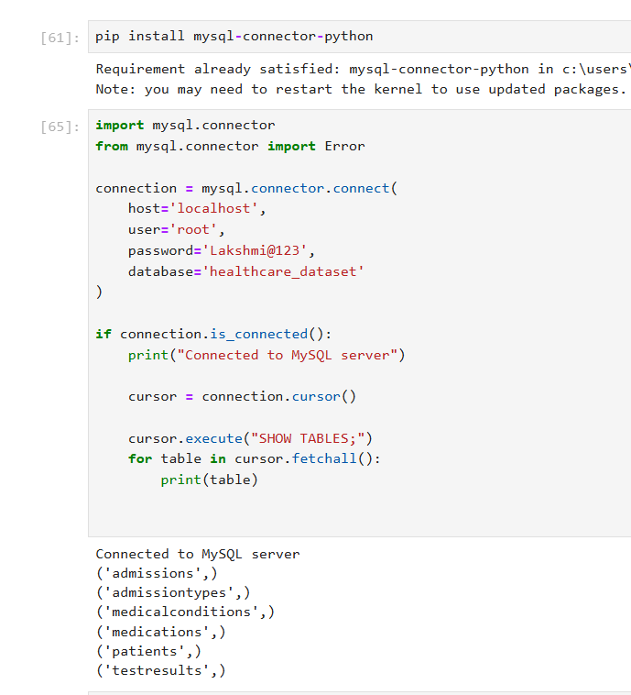

Slide 19

QUERY & DATA VISUALIZATION

Slide 20
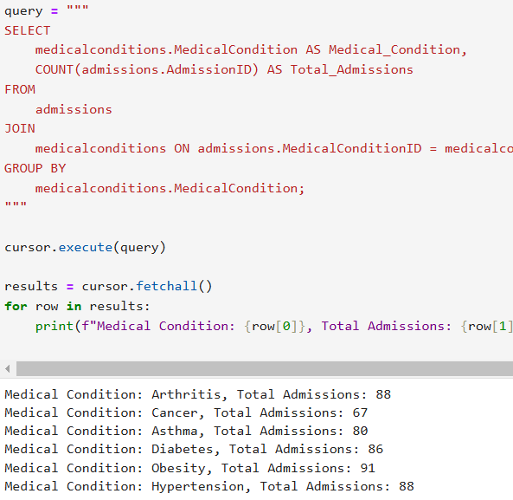
How many admissions are associated with each medical condition?

Slide 21
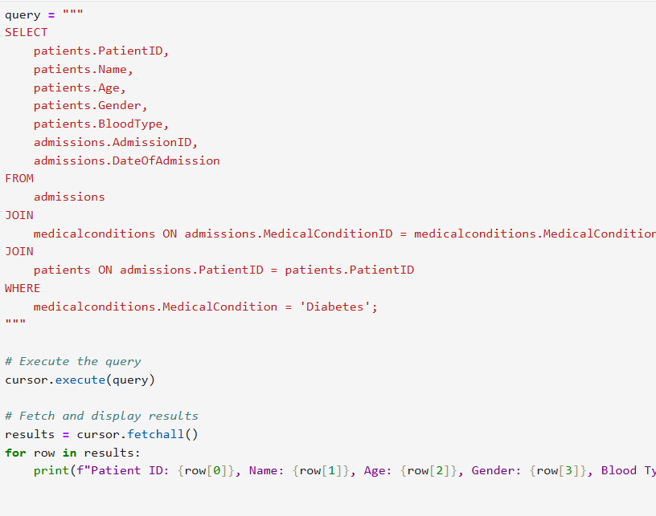
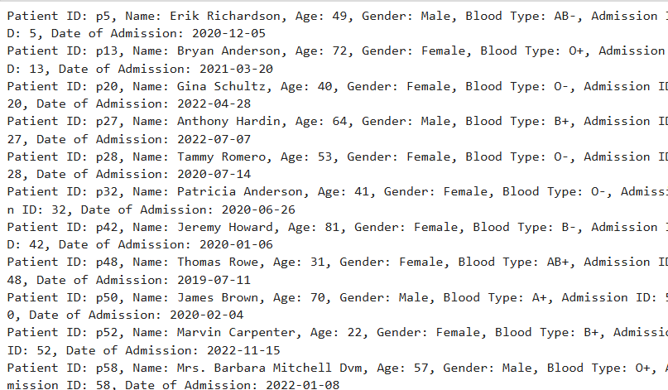
Which patients have admissions related to diabetes?

Slide 22
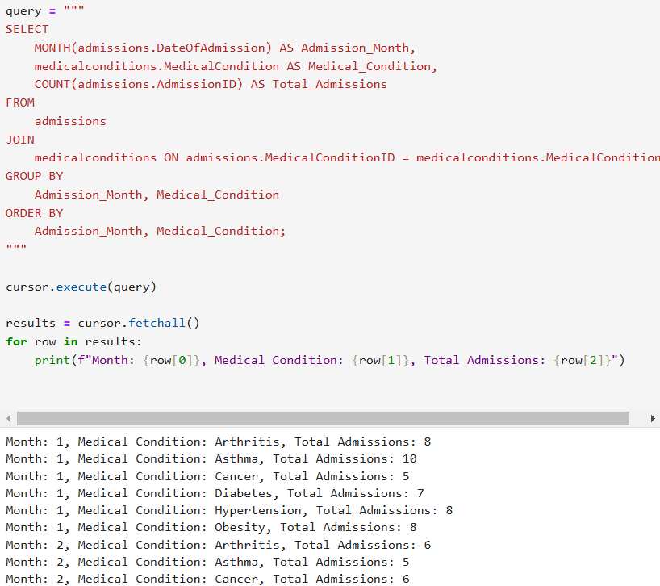
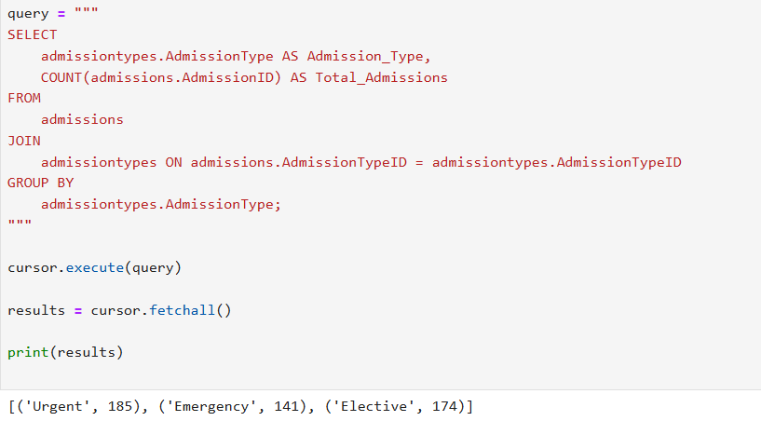
What are the monthly trends for admissions based on medical conditions?
How many admissions are there for each admission type?

Slide 23
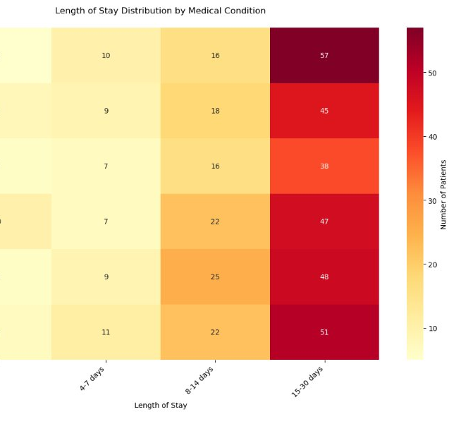
HEAT MAP
Output Explanation:
Arthritis and Asthma show a high concentration of patients in the 0–3 day stay category (57 and 45 patients, respectively).
Hypertension, Diabetes, and Obesity show a significant number of patients in the 15–30 day category (48, 47, and 51 patients, respectively).
Cancer patients are evenly distributed across the stay durations, indicating varied treatment complexities.
Reason for Performing:
To examine patterns in hospital stay lengths for patients with different conditions.
Prolonged stays for obesity, diabetes, and hypertension indicate the need for targeted long-term care plans and resource allocation.
Shorter stays for asthma and arthritis suggest quicker treatment turnover, which impacts bed availability and staffing.

Slide 24
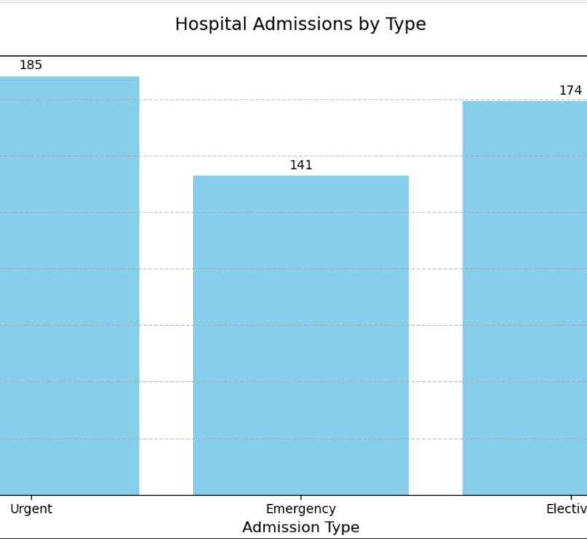
BAR CHART
Output Explanation:
Urgent admissions are the highest (185), followed by Elective admissions (174), with Emergency admissions being the least frequent (141).
The relatively higher number of urgent admissions highlights the need for prioritization in healthcare services that address time-sensitive but non-critical cases.
Reason for Performing:
To identify the distribution of different admission types.
This helps hospital management allocate resources efficiently, ensuring staff and facilities are prepared for the most frequent admission types, particularly urgent and elective cases.

Slide 25
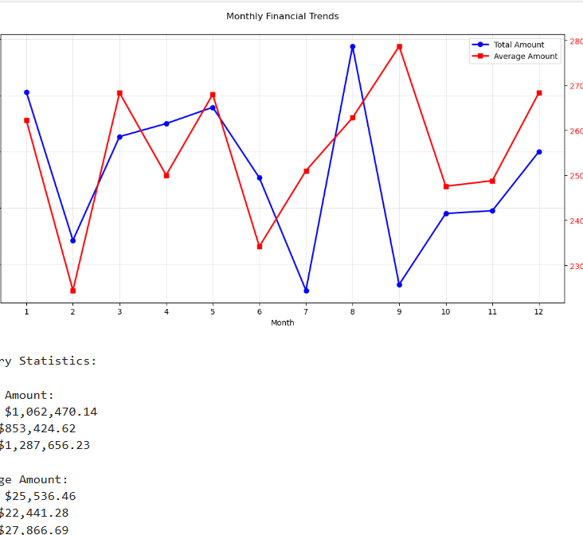
LINE PLOT
Output Explanation:
The Total Amount shows significant fluctuations across the year, with peaks in months 3, 6, and 9. A noticeable dip occurs in month 7, which might indicate reduced patient intake or a seasonal trend.
The Average Amount per patient remains fairly stable but shows minor increases in months with higher total revenue.
Reason for Performing:
To track and analyze revenue trends across the year.
Peaks and troughs in total revenue can point to seasonality in patient admissions, allowing financial planners to anticipate income variations and prepare accordingly.
Insights from average billing trends can guide pricing strategies or identify discrepancies in revenue collection.

Slide 26
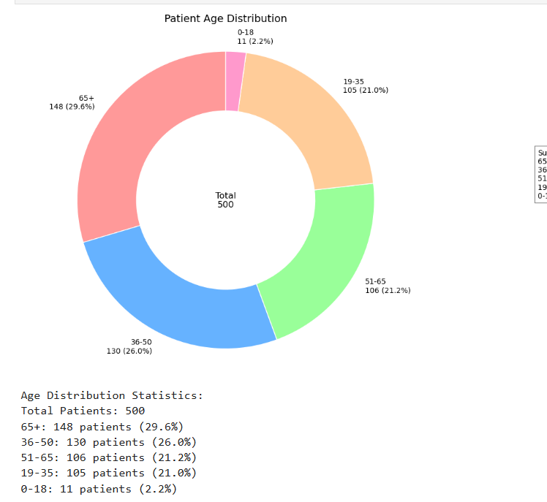
DONUT CHART
Output Explanation:
The largest patient group is 65+ years old (29.6%), followed by the 36–50 years (26%) and 51–65 years (21.2%) age brackets.
The 0–18 years age group constitutes the smallest proportion (2.2%), indicating less pediatric patient intake.
Reason for Performing:
To understand the age demographics of hospital patients.
The large elderly population (65+) emphasizes the need for geriatrics-focused care and specialized services.
Lower representation of pediatric cases suggests either a lower demand or the presence of alternative pediatric facilities.

Slide 27
Future Plans
To enhance the usability and scalability of our database, future work will focus on integrating larger and more diverse healthcare datasets to represent broader patient populations. Expanding the schema to incorporate additional attributes, such as treatment outcomes and patient follow-ups, will enable more comprehensive analysis. Employing advanced data analytics techniques, such as machine learning models, can uncover deeper insights into patient care trends and predict outcomes like length of stay or readmission risk. Developing a fully functional frontend and backend system will provide seamless interaction and improve accessibility for healthcare providers. Continuous validation and updates to the database will ensure its adaptability to evolving healthcare needs, ultimately driving better decision-making and improved patient care.

Slide 28

Challenges
One hurdle I encountered during the project was linking the SQL server with Python. This issue primarily arose due to mismatched configurations, such as incorrect driver installation, authentication errors.

Slide 29


